Slide 1
Inverse Design of a Tunable Silicon Photonic Device using Machine Learning
ECE228 project by group #14
Li-Yuan Chiang, Ya-Chien Chang, and Wei-Ru Lin
6/3/2021

Slide 2
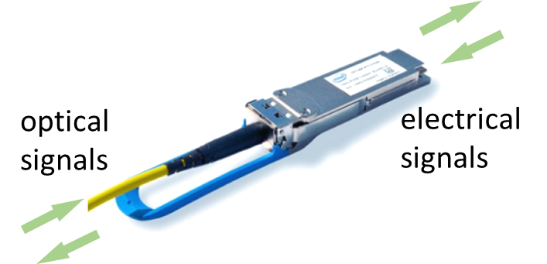
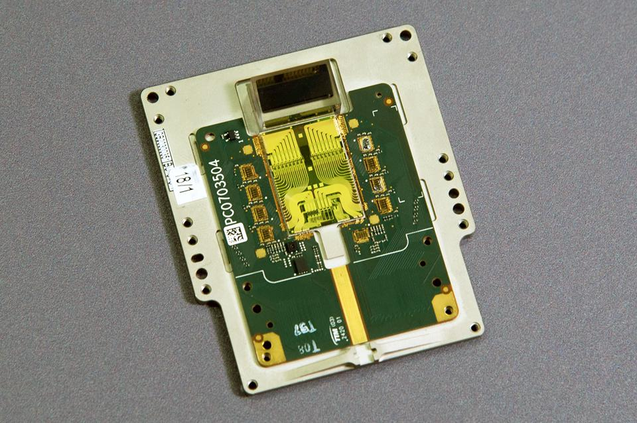
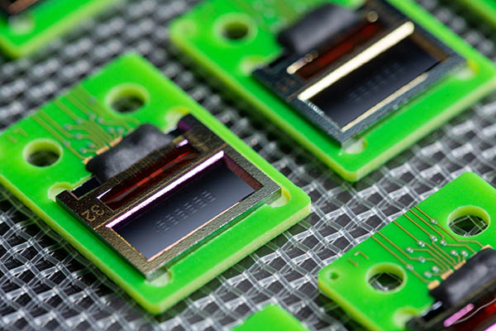


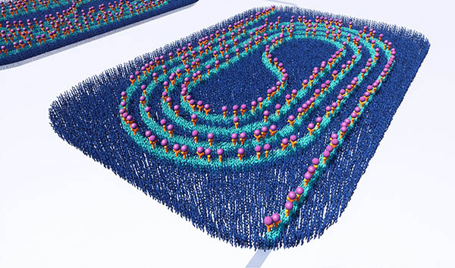
Silicon Photonics
Fiber-optic communications
LiDAR System-On-Chip
Biosensing
(Intel Mobileye)
(PHIX)

Slide 3
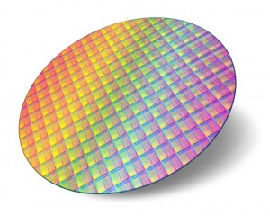

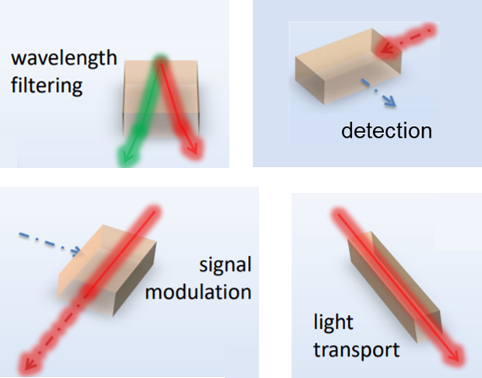
Silicon Photonics
Smaller device footprint → lower cost
Challenge: shrink device size while maintaining good performance
Silicon wafer
Photonic IC
Photonic devices
…etc
W. Bogaerts et al., OFC (2018)

Slide 4
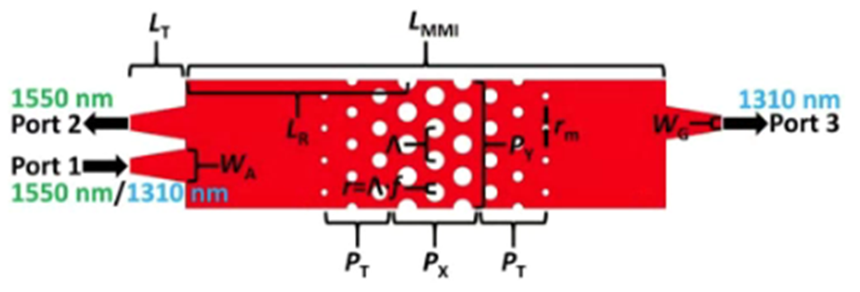
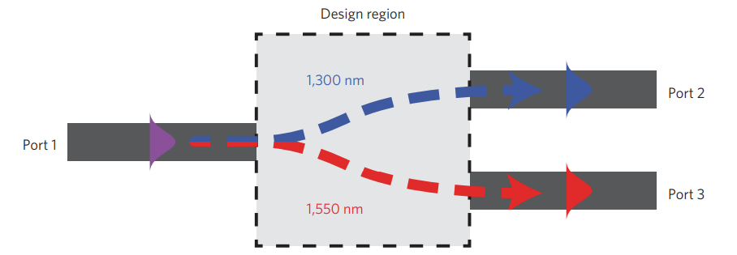
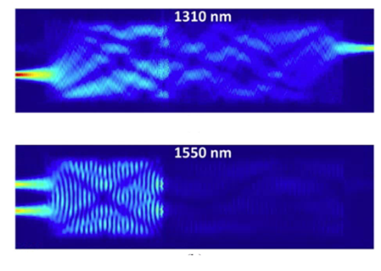
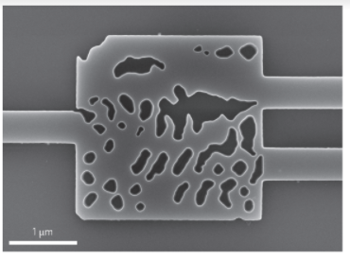
How ML can Help
Ex: wavelength demultiplexer device
Case A:
Case B:
5 μm × 130 μm
2.8 μm × 2.8 μm
Only 1.2% of area occupied!
L. Xu et al., Optics Letters (2019)
A. Y. Piggott et al., Nature Photonics (2015)

Slide 5

Tunable Device by Inverse Design
Wavelength demultiplexer (passive device)
Optical switch (active device)
Δn_{Si} = 0
2.8 μm × 2.8 μm
Δn_{Si} = 0.1
A. Y. Piggott et al., Nature Photonics (2015)

Slide 6
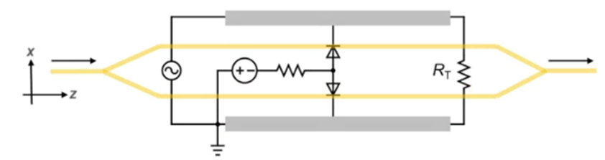
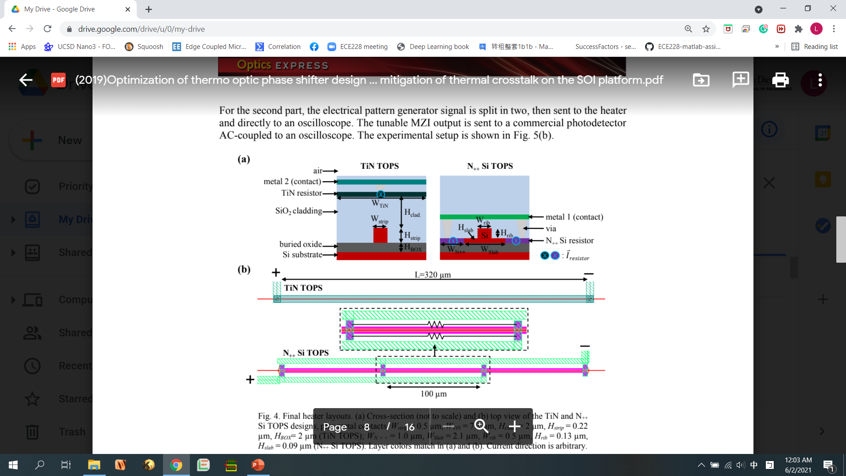
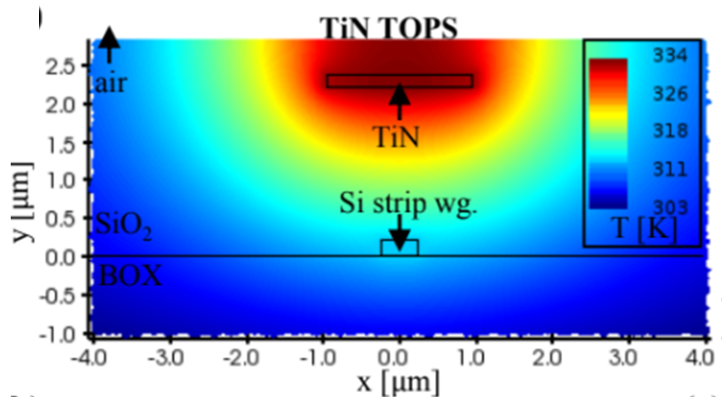
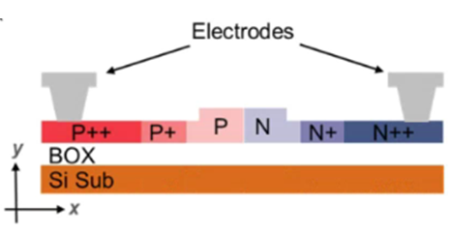
Silicon Optical Switch
Electro-optic switch (Carrier depletion)
Thermo-optic switch
(top view)
(top view)
5000-μm long
induce Δn_{Si}
320-μm long
(cross section)
(cross section)
J. Wang et al., Journal of Lightwave Technology (2020)
M. Jacques et al., Optics Express (2019)

Slide 7

Dataset
A 3D matrix (100*100*7) of neurons are set
Each neuron in the 2D array (100*100) has a random value between 0 and 1
The same 2D pattern is duplicated to each layer
0.04 μm
0.04 μm
4 μm
4 μm

Slide 8
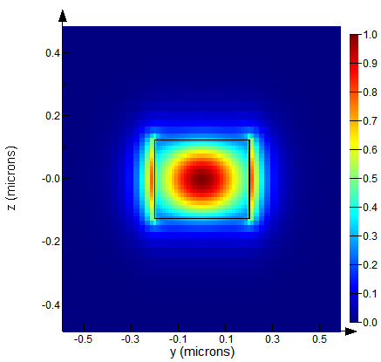
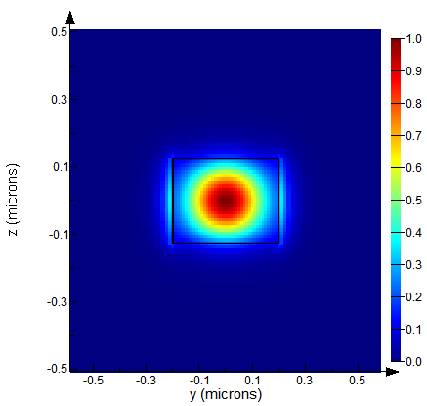
Feature
Refractive indices, n, of materials affect light propagation behaviors in waveguides
Two n_{Si} are set as features
Si waveguide
Cross-sectional optical profiles
n_{Si} = 3.48
(Δn_{Si} = 0)
n_{Si} = 4.48
(Δn_{Si} = 1)
Si
SiO₂

Slide 9
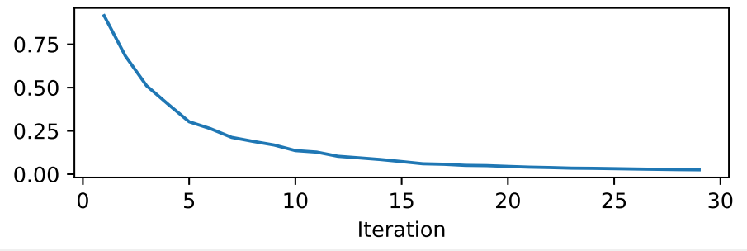
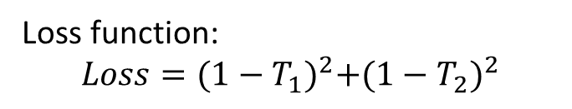
Model
Using a Maxwell solver, the light propagation behavior is simulated, and the output transmission at the certain output channel can be calculated
Δn_{Si} = 0
Loss function:
$$Loss={(1−T_{1})}^{2}+{(1−T_{2})}^{2}$$
T₁
Target transmission
training loss minimized with gradient descent algorithm
T: Transmission
Δn_{Si} = 0.1
T₂

Slide 10
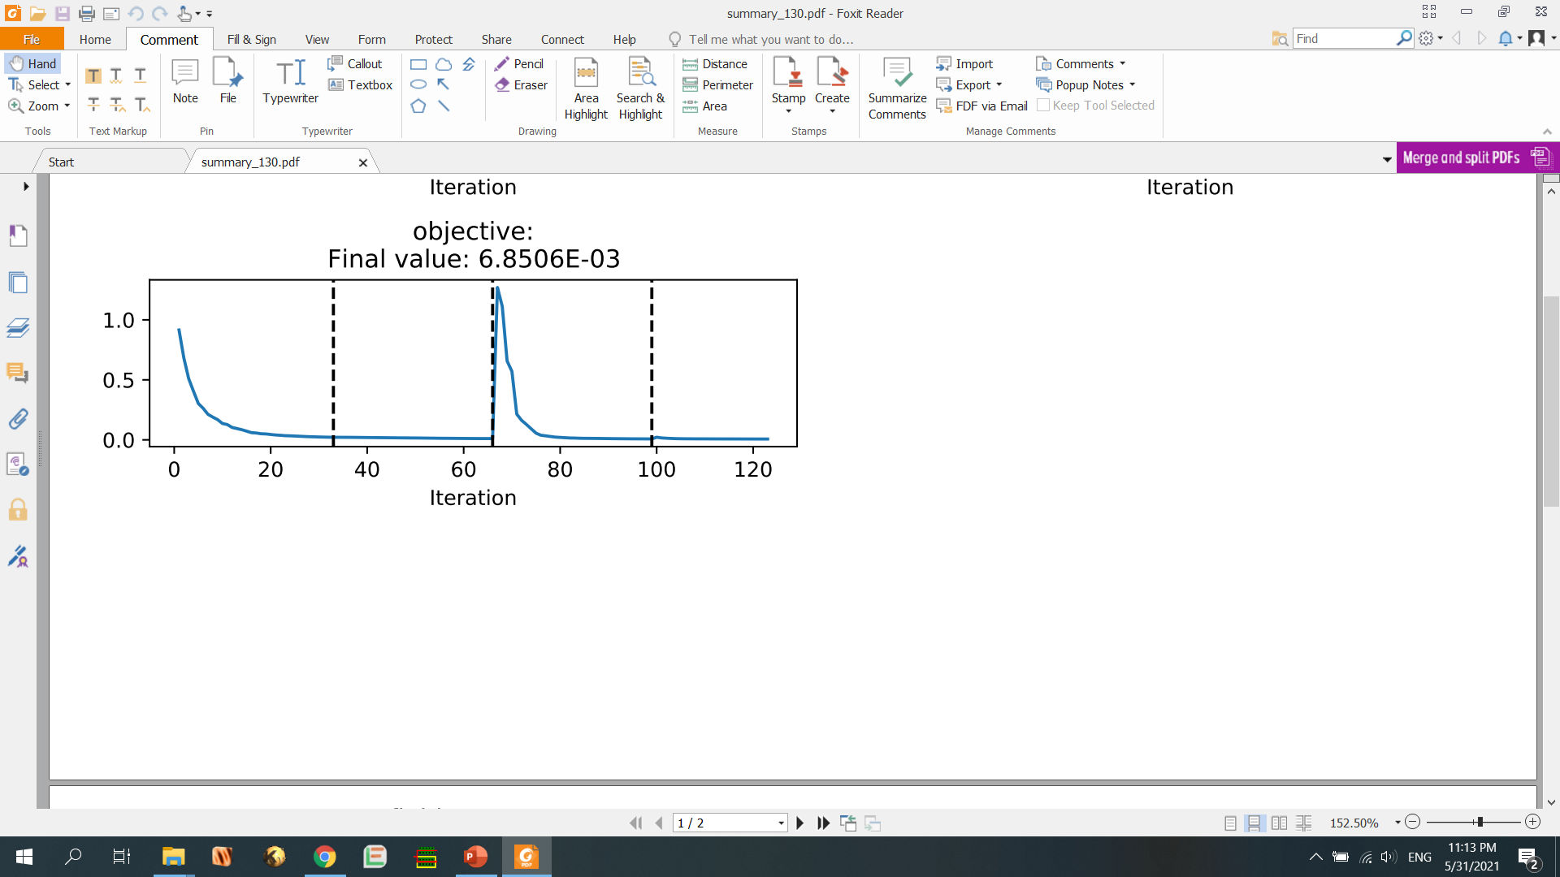
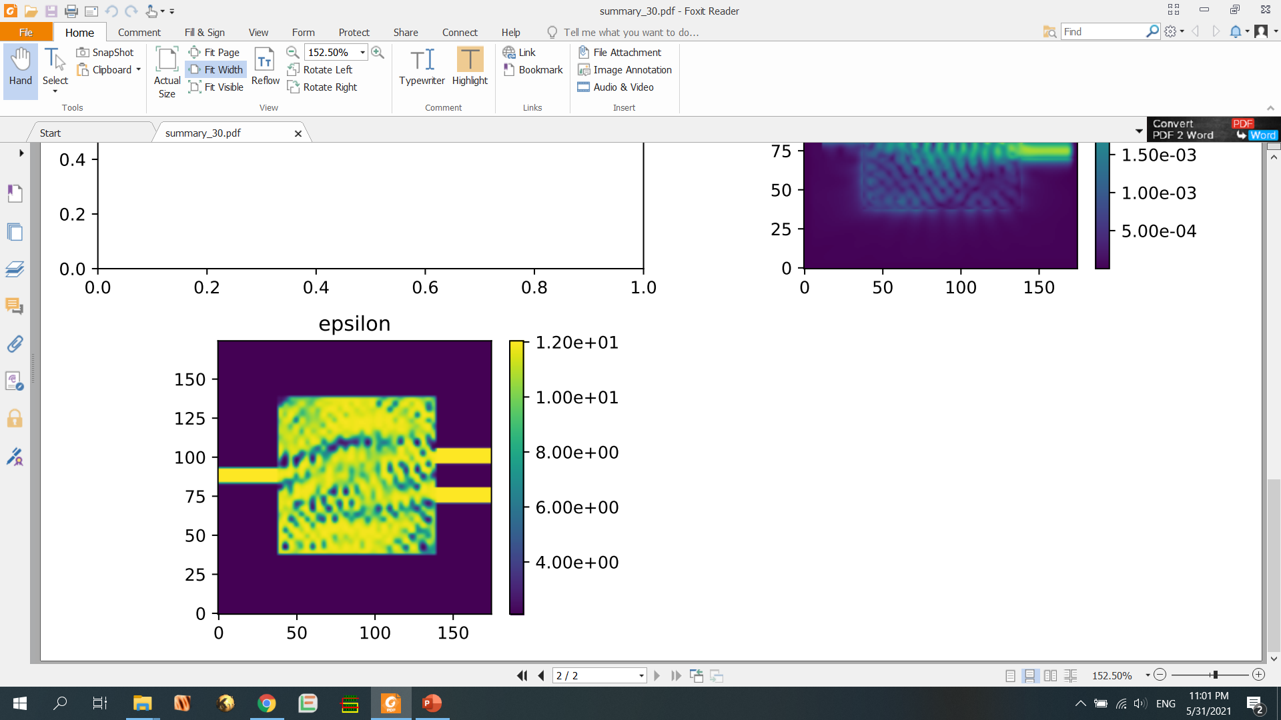
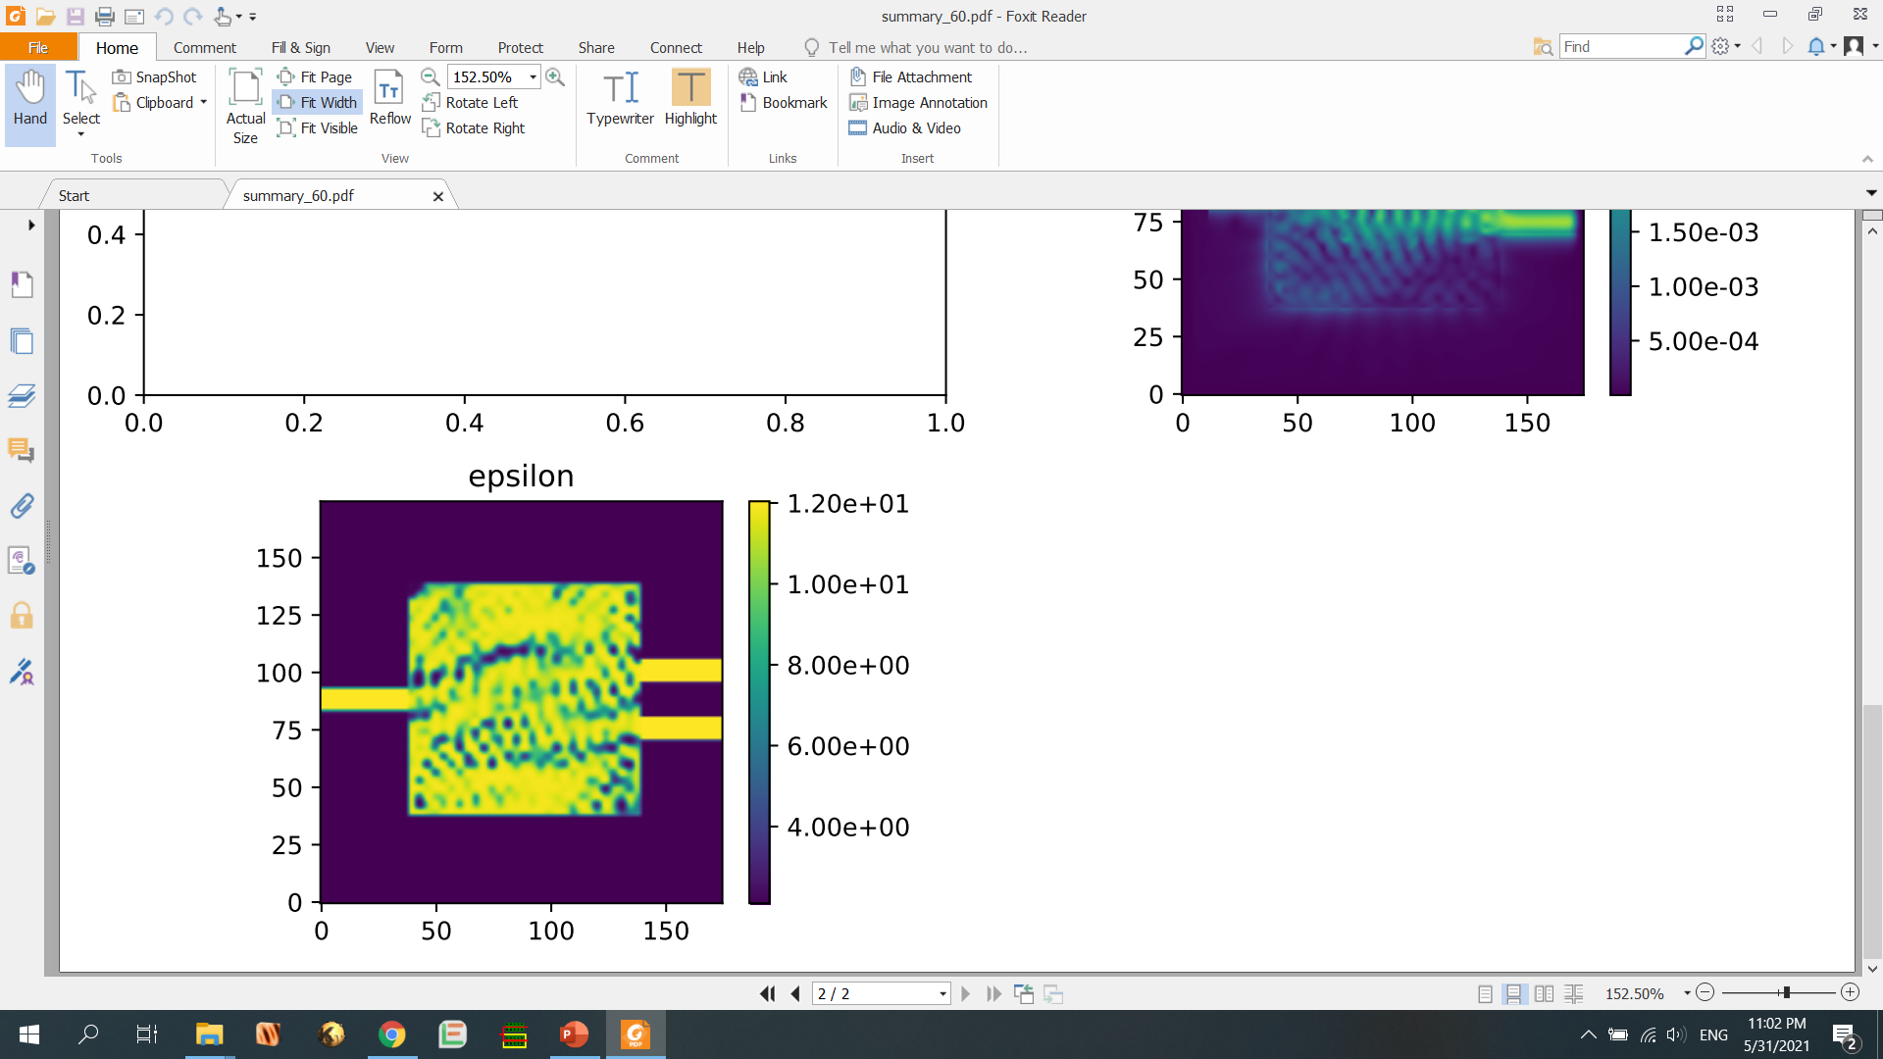
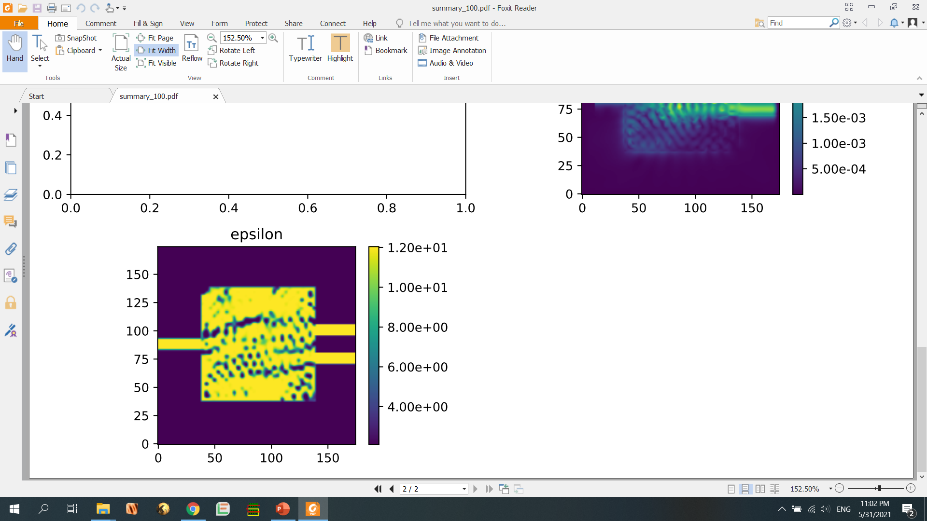

Model
Learning curve of training loss:
(Sigmoid function applied for each neuron at the beginning of each stage)
Optimization
material index
stage#1
stage#2
stage#3
stage#4

Slide 11
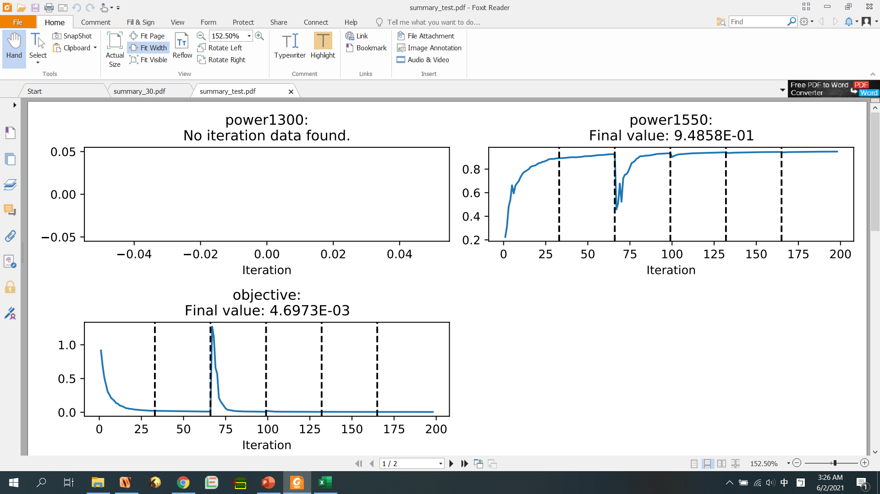
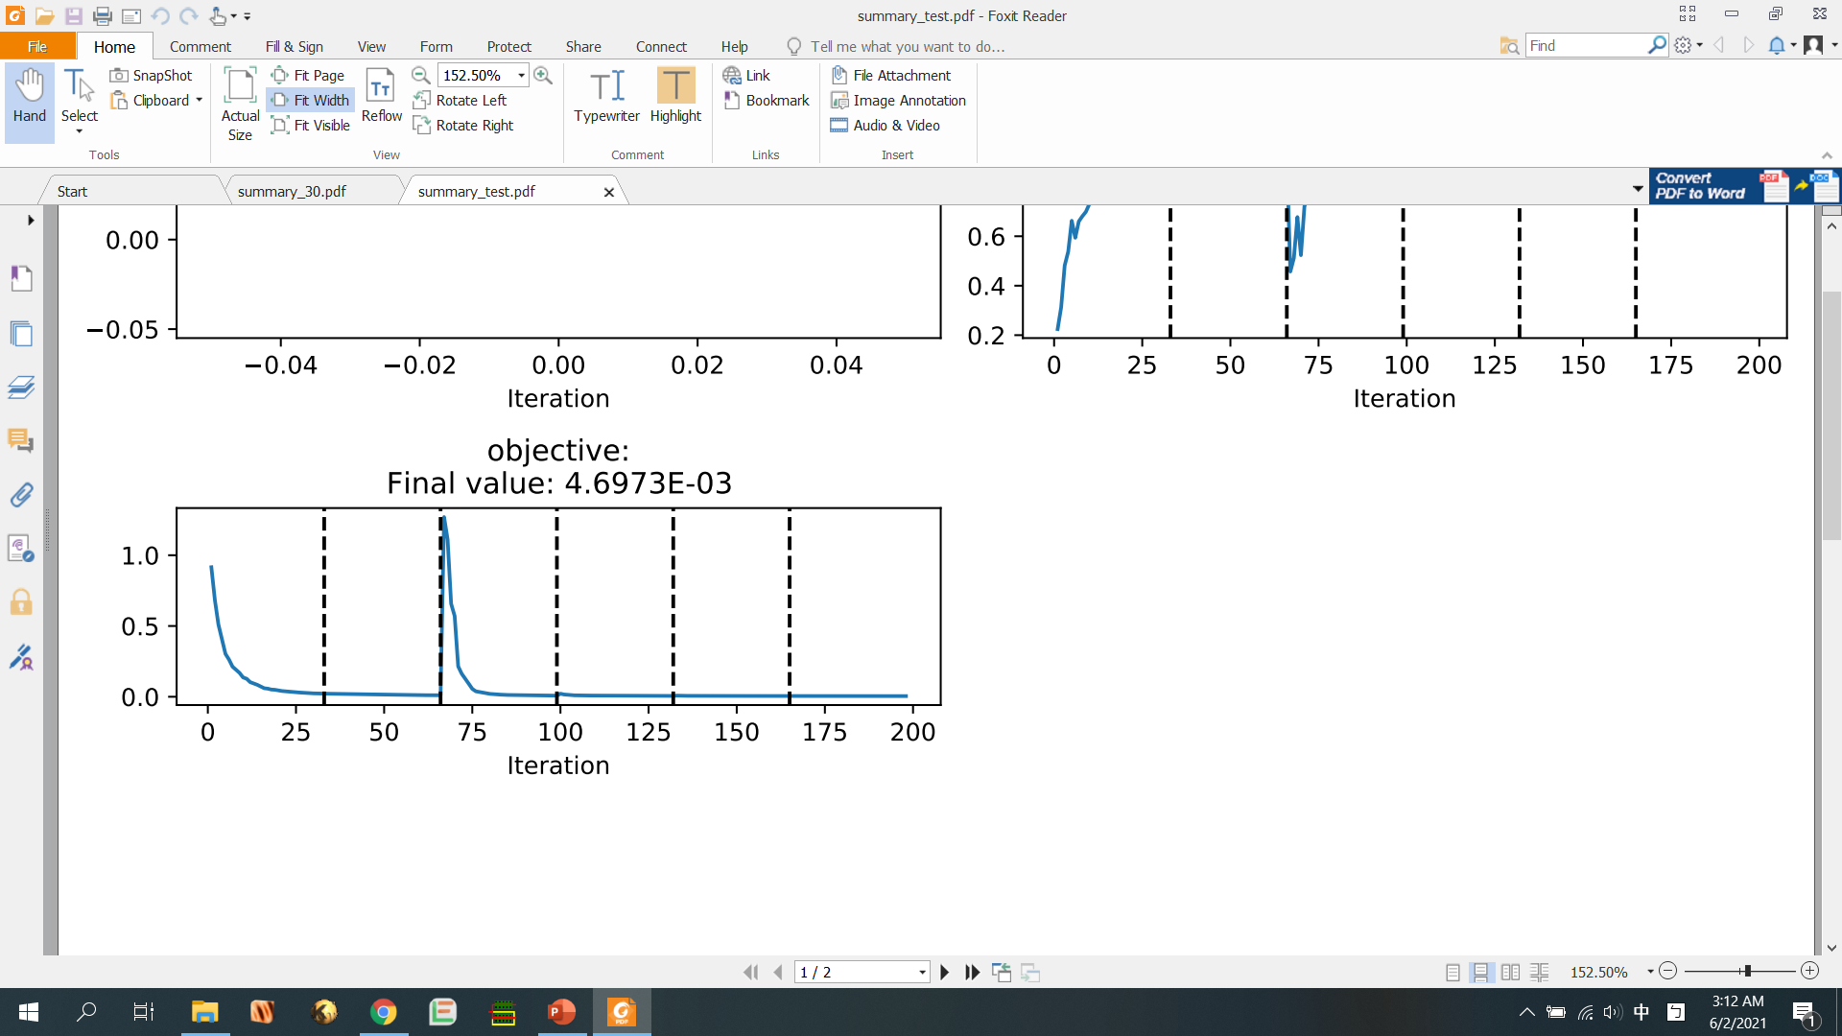
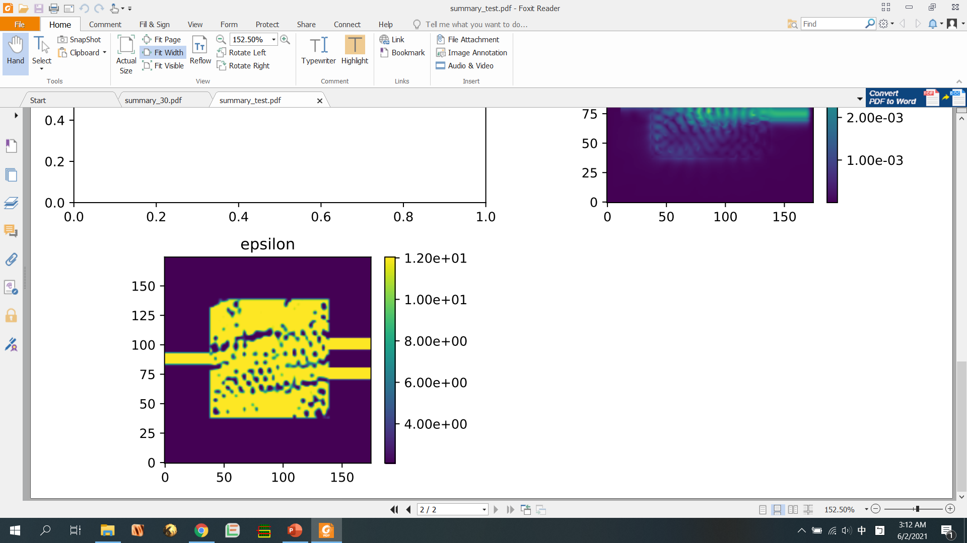
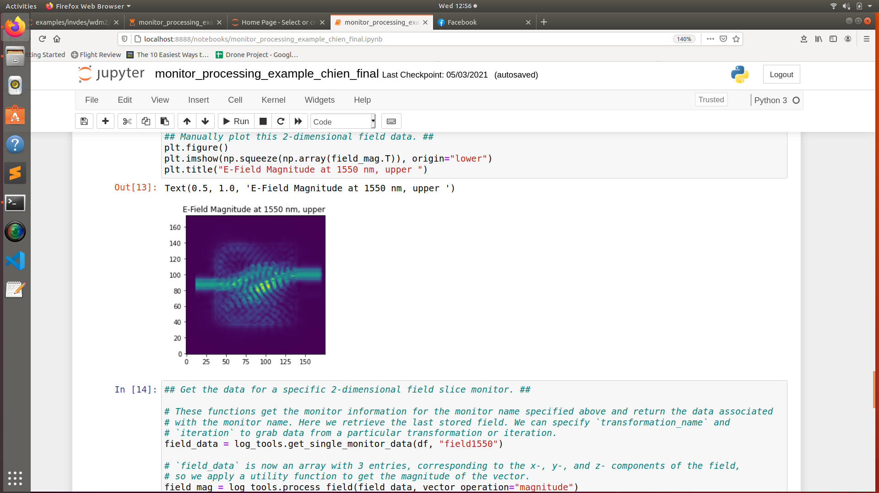
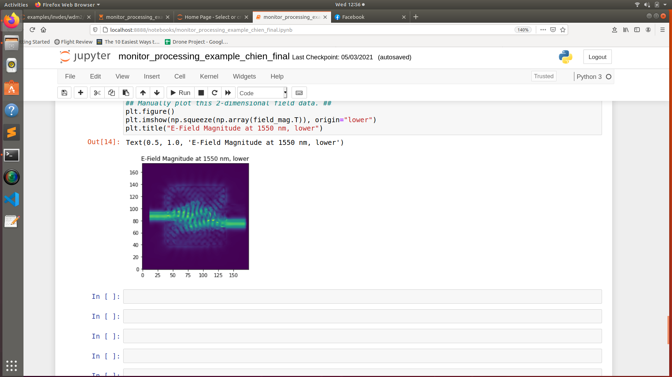
Results
training T₁
training loss
0.948
trained pattern
testing result (Δn_{Si} = 0)
testing result (Δn_{Si} = 0.1)
testing T₁ = 0.899
testing T₂ = 0.894

Slide 12
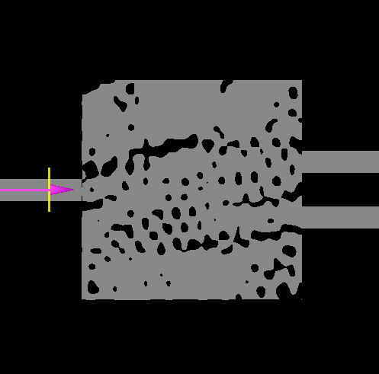
Results
Intermediate values (blurred regions) are not allowed in real cases
The trained pattern is forced to become binary values for the final design
SiO₂
Si

Slide 13
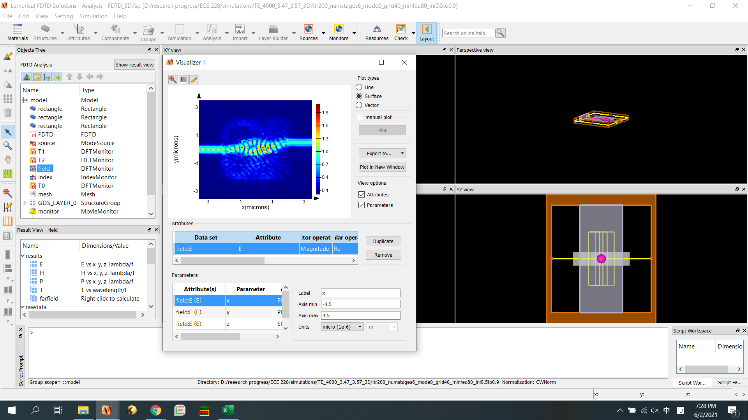
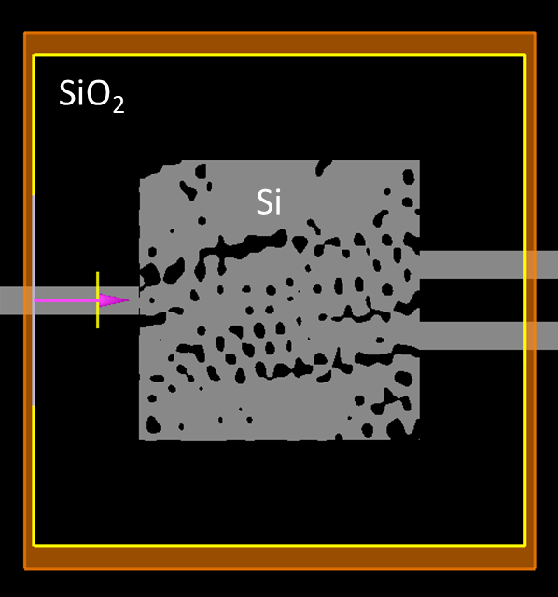
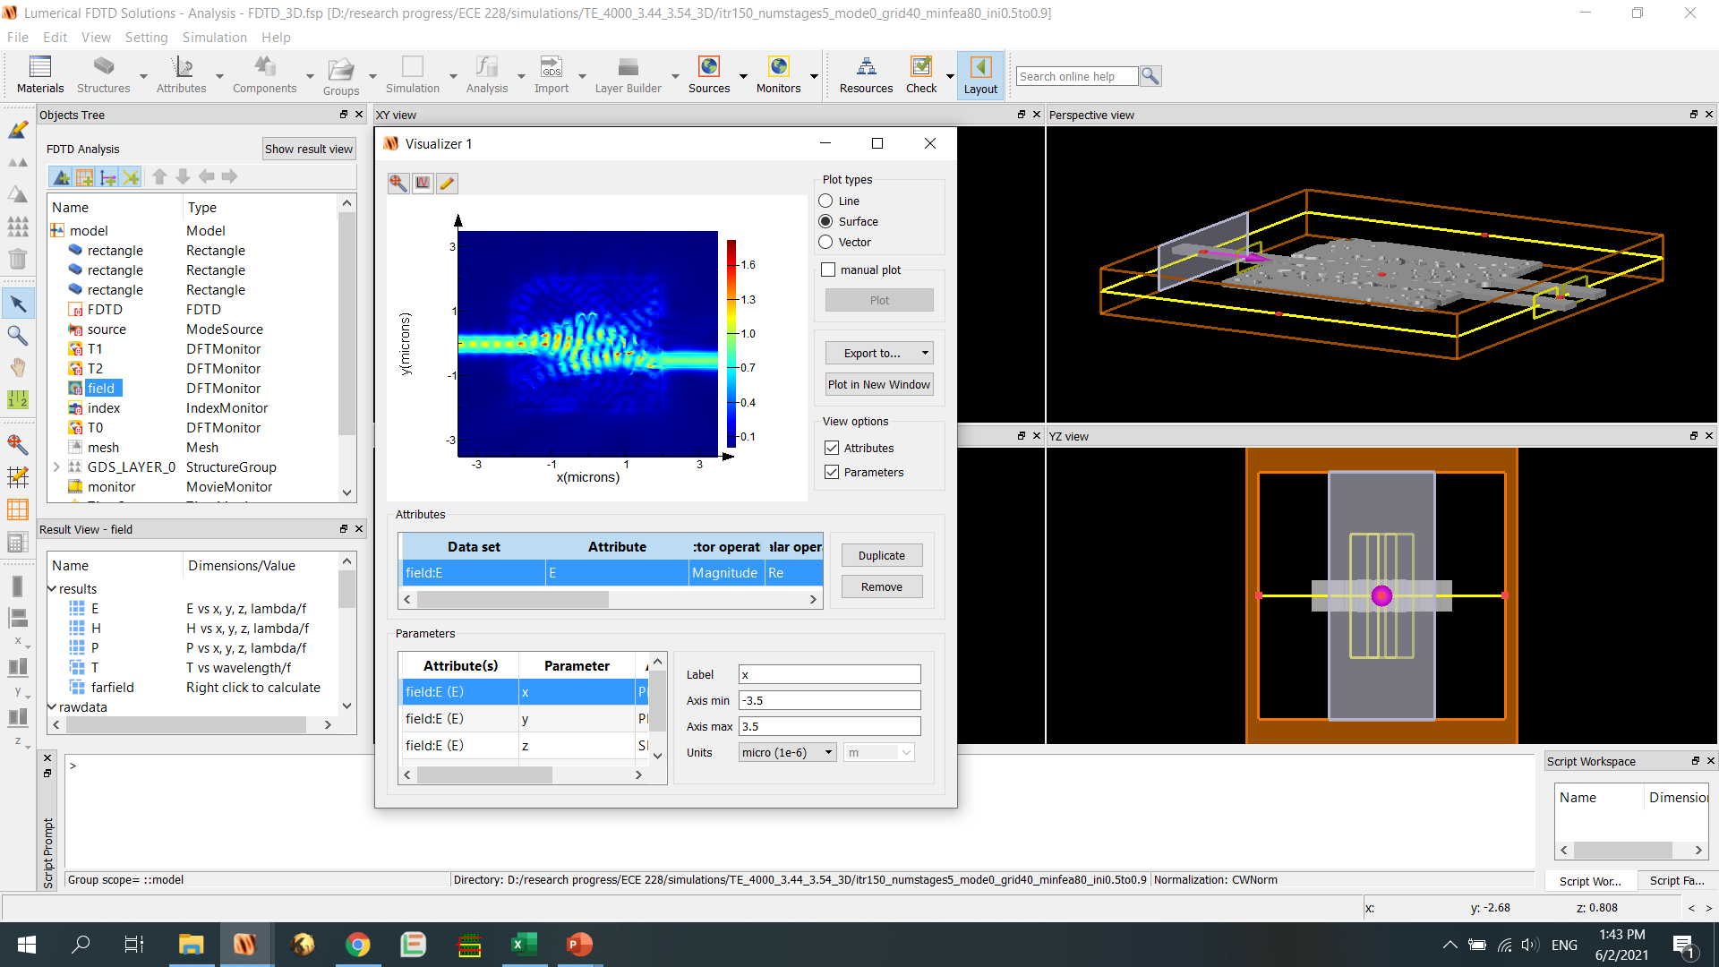
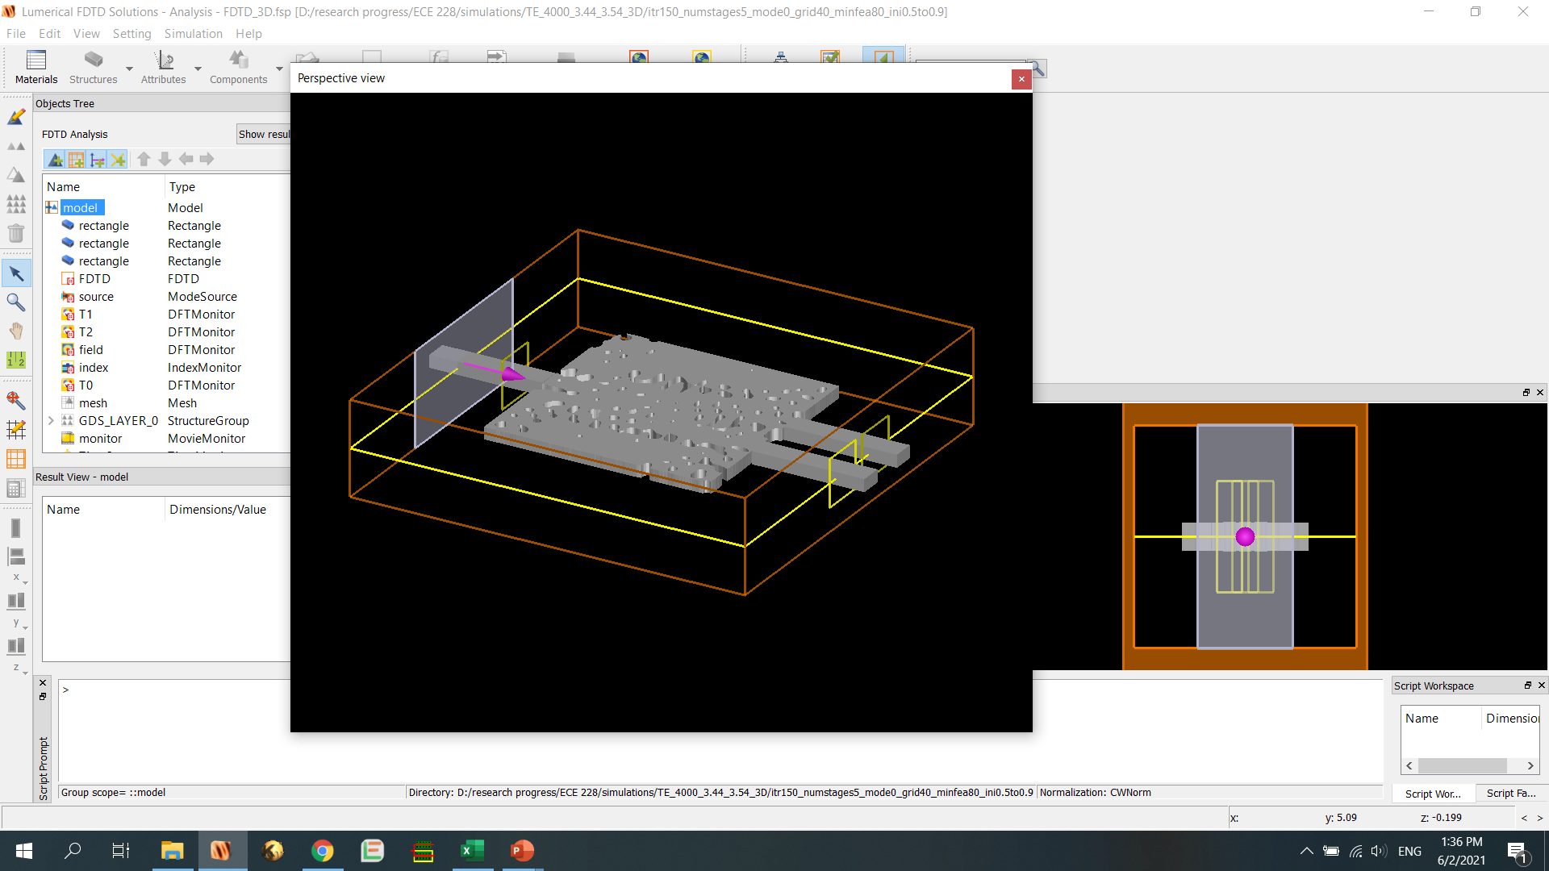
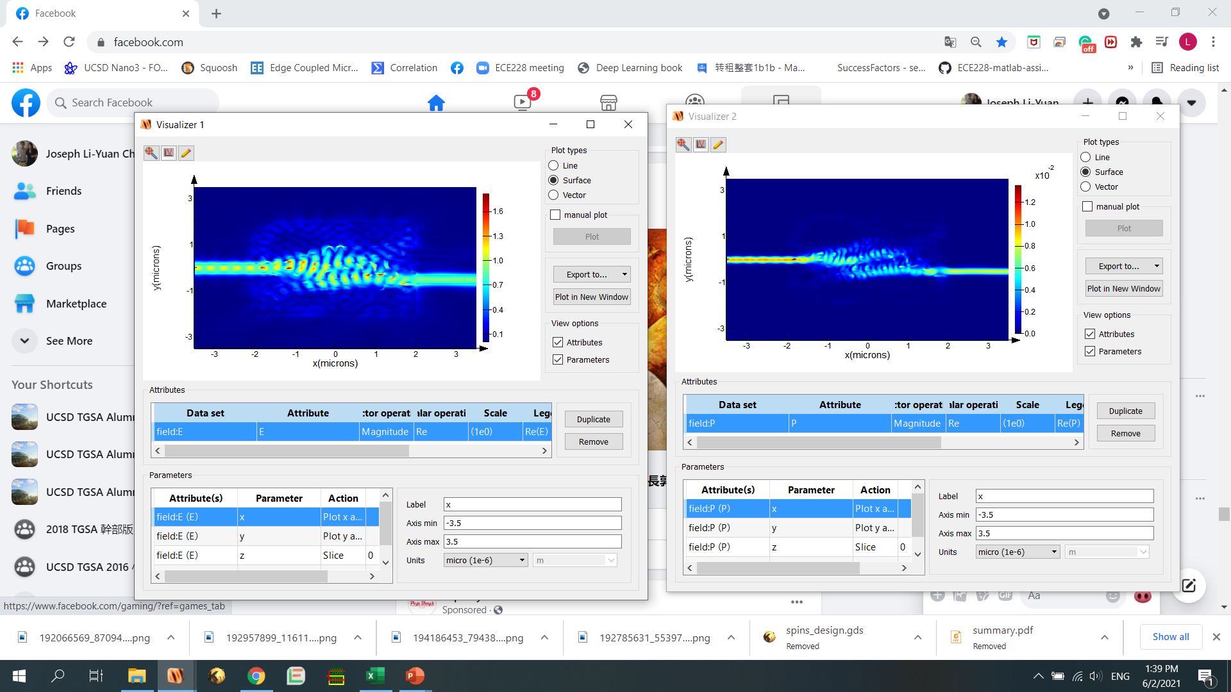
Results
Commercial software Lumerical is used for data validation
(top view)
validating T₂ = 0.830
testing T₁ = 0.899
(tilted view)
validating T₂ = 0.842
testing T₂ = 0.894

Slide 14
Conclusion
A key challenge in silicon photonics is to realize various kinds of devices with compact size and high performance
Inverse design methods have shown strong potentials for silicon photonic design
We demonstrated a 4μm*4μm silicon photonic switch design with < 1dB optical loss using deep learning
Si
Notes:
.

Slide 15
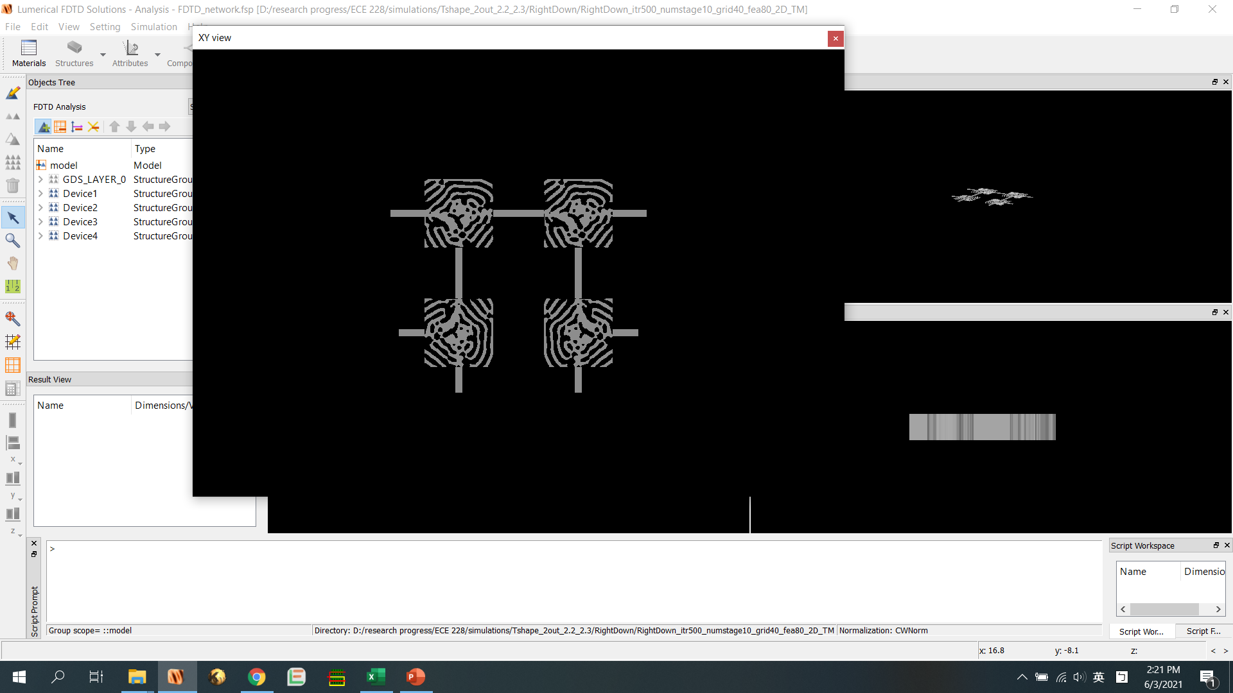
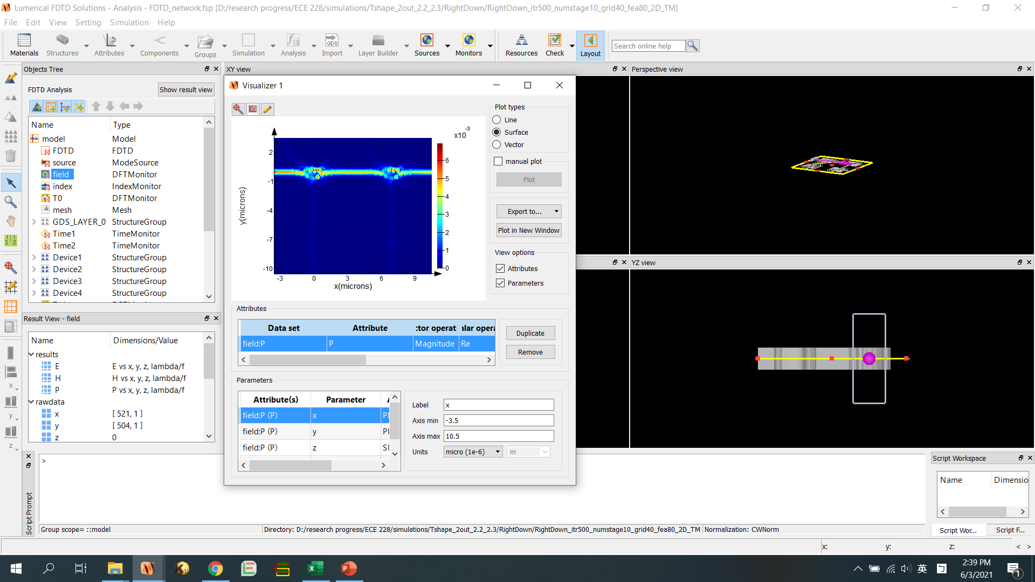
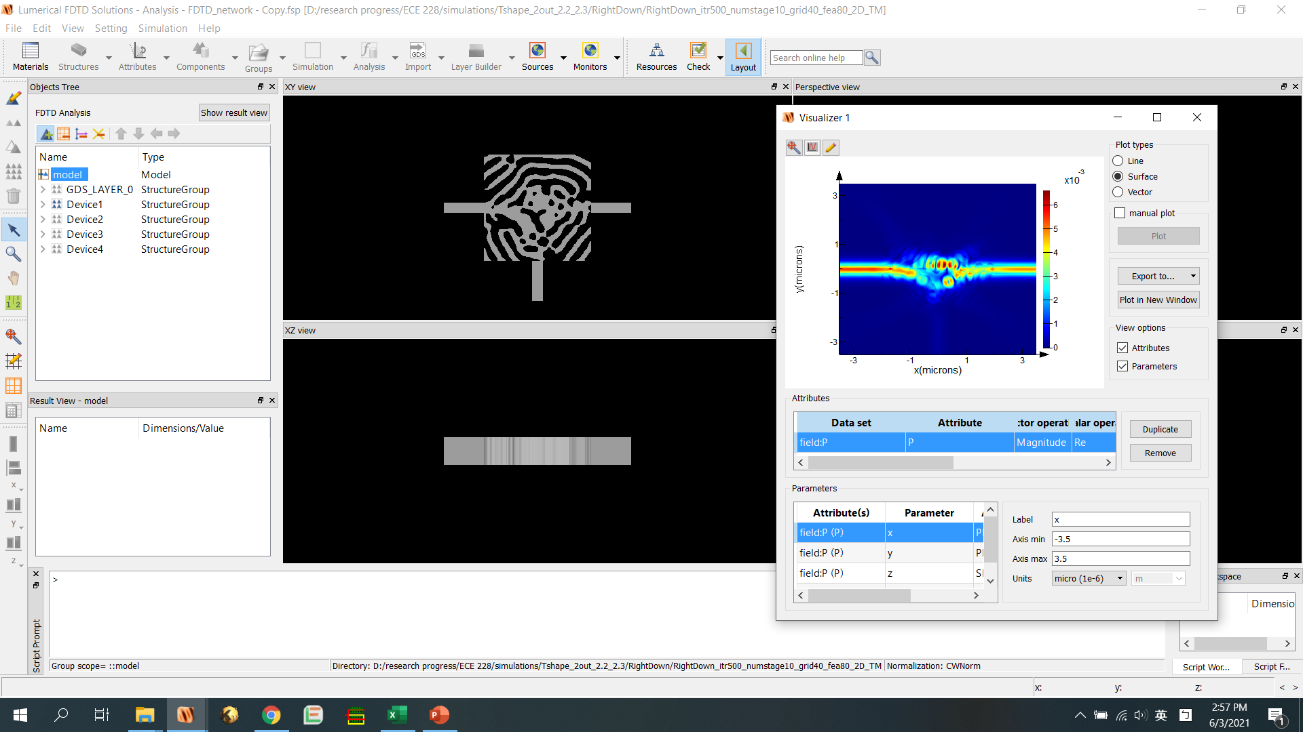
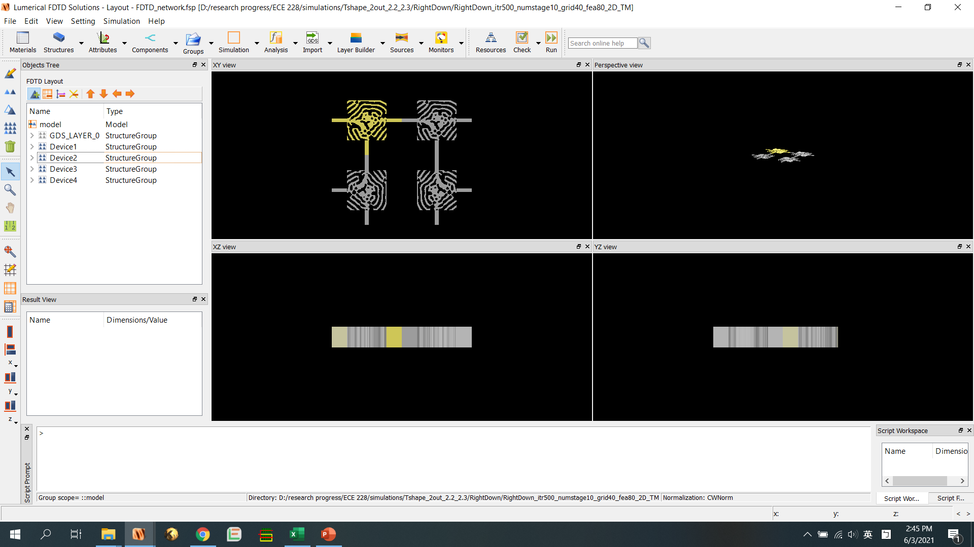
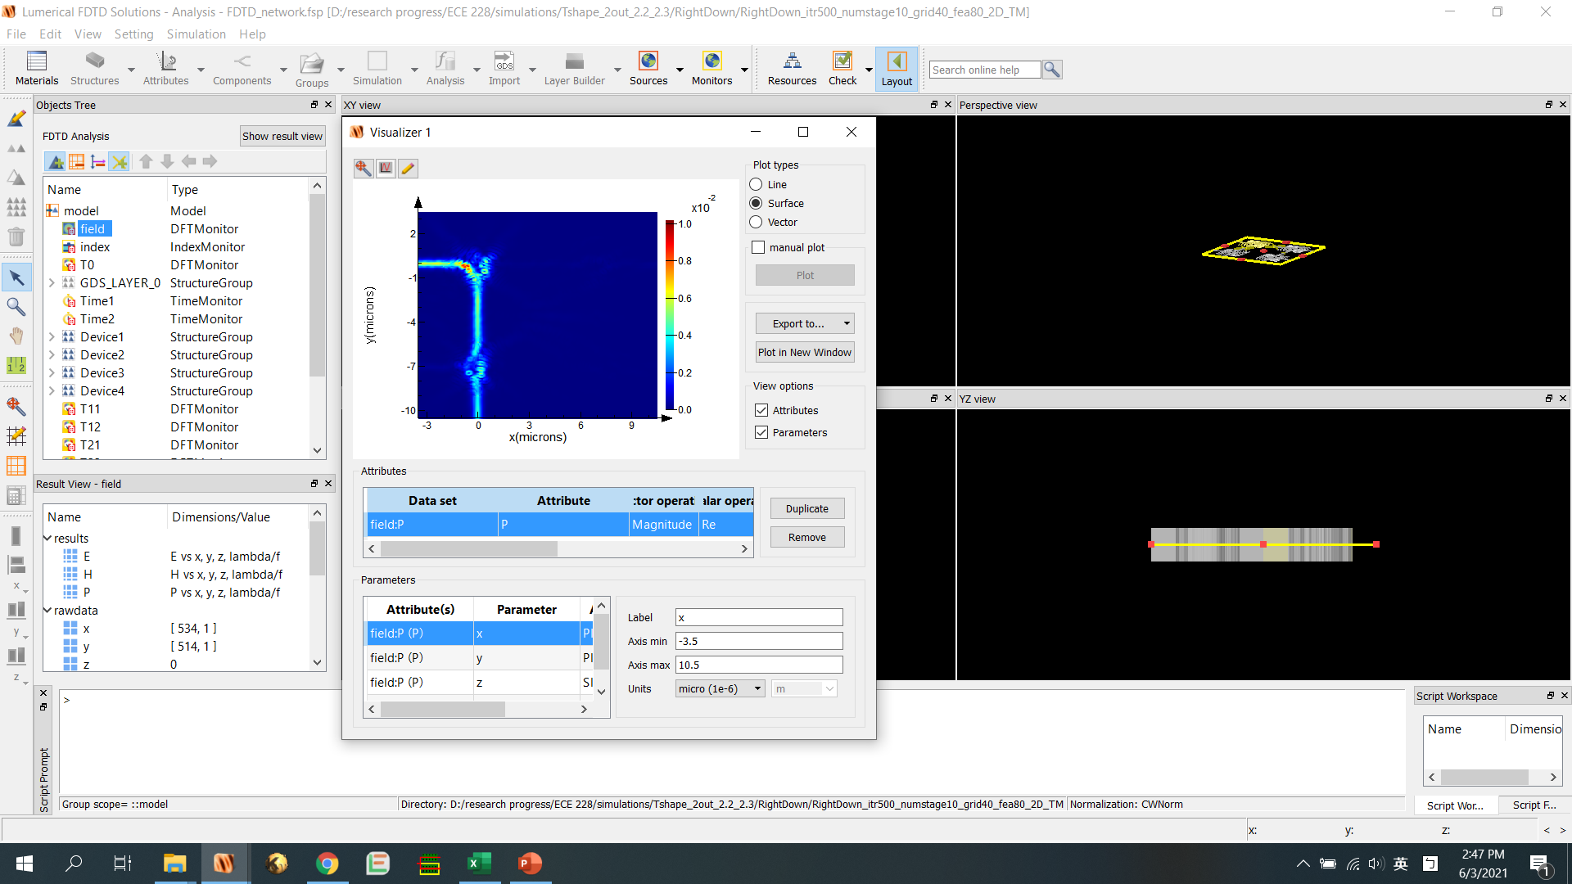
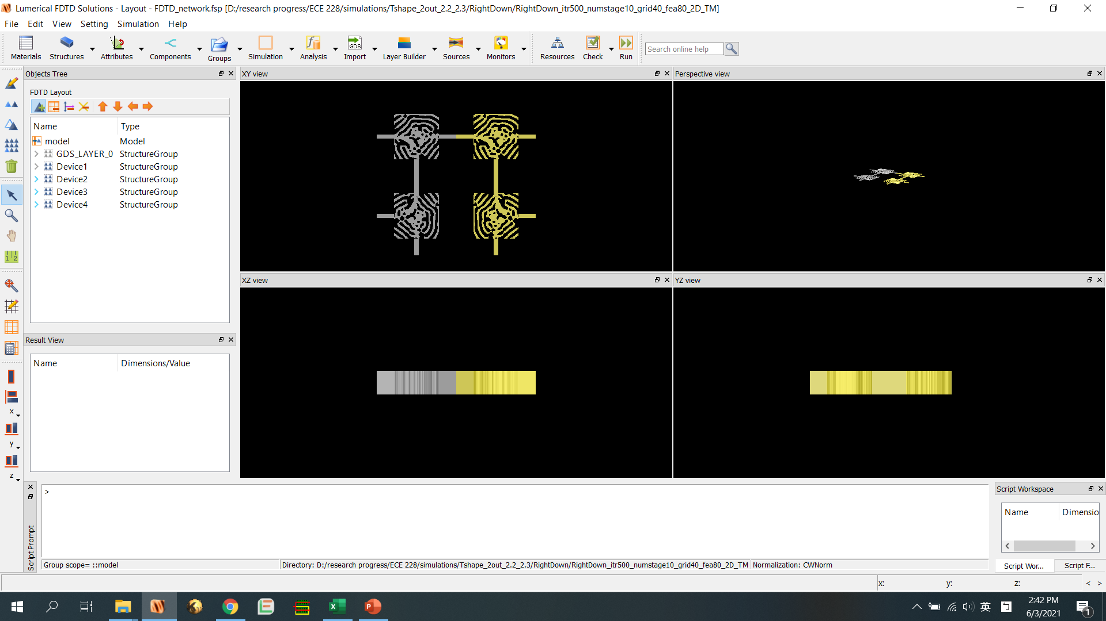
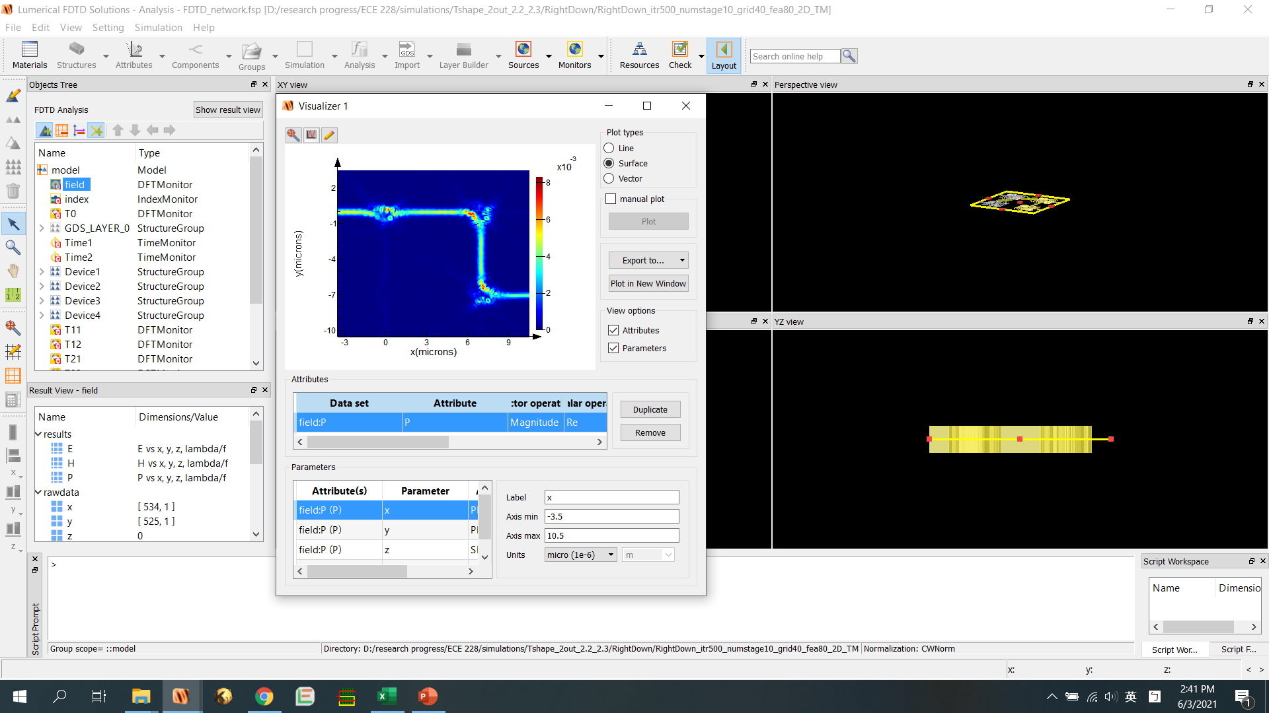
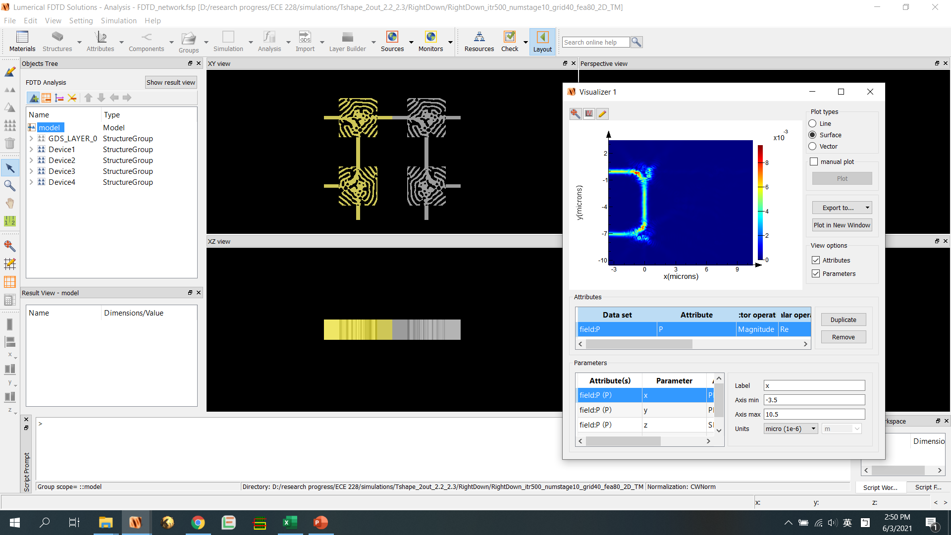
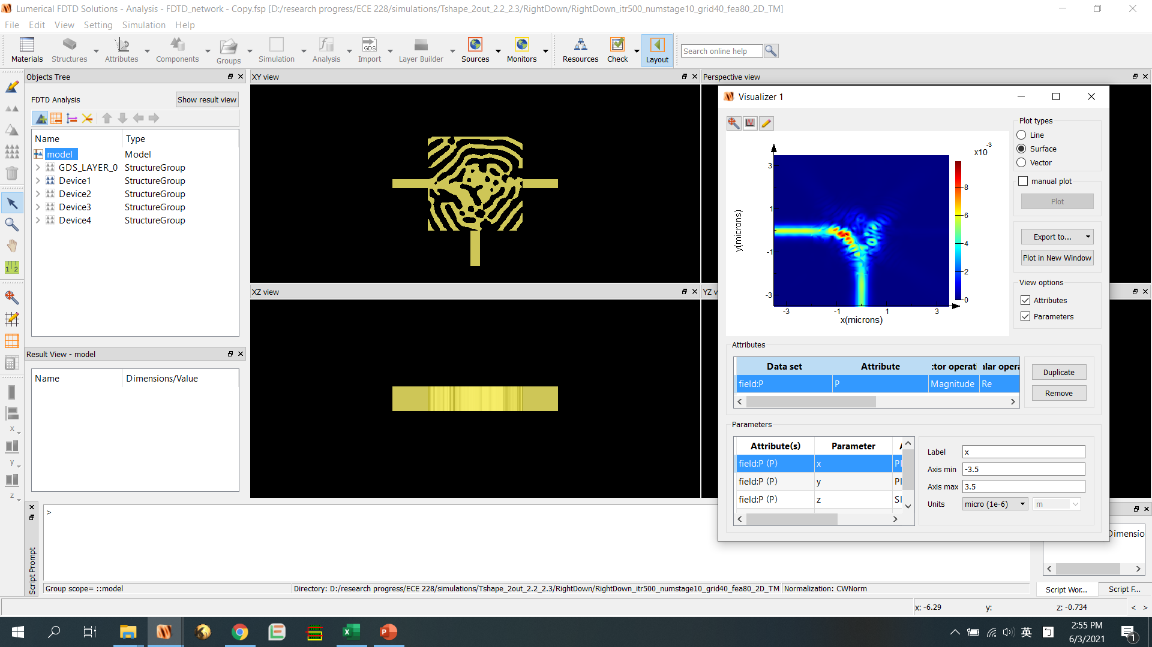
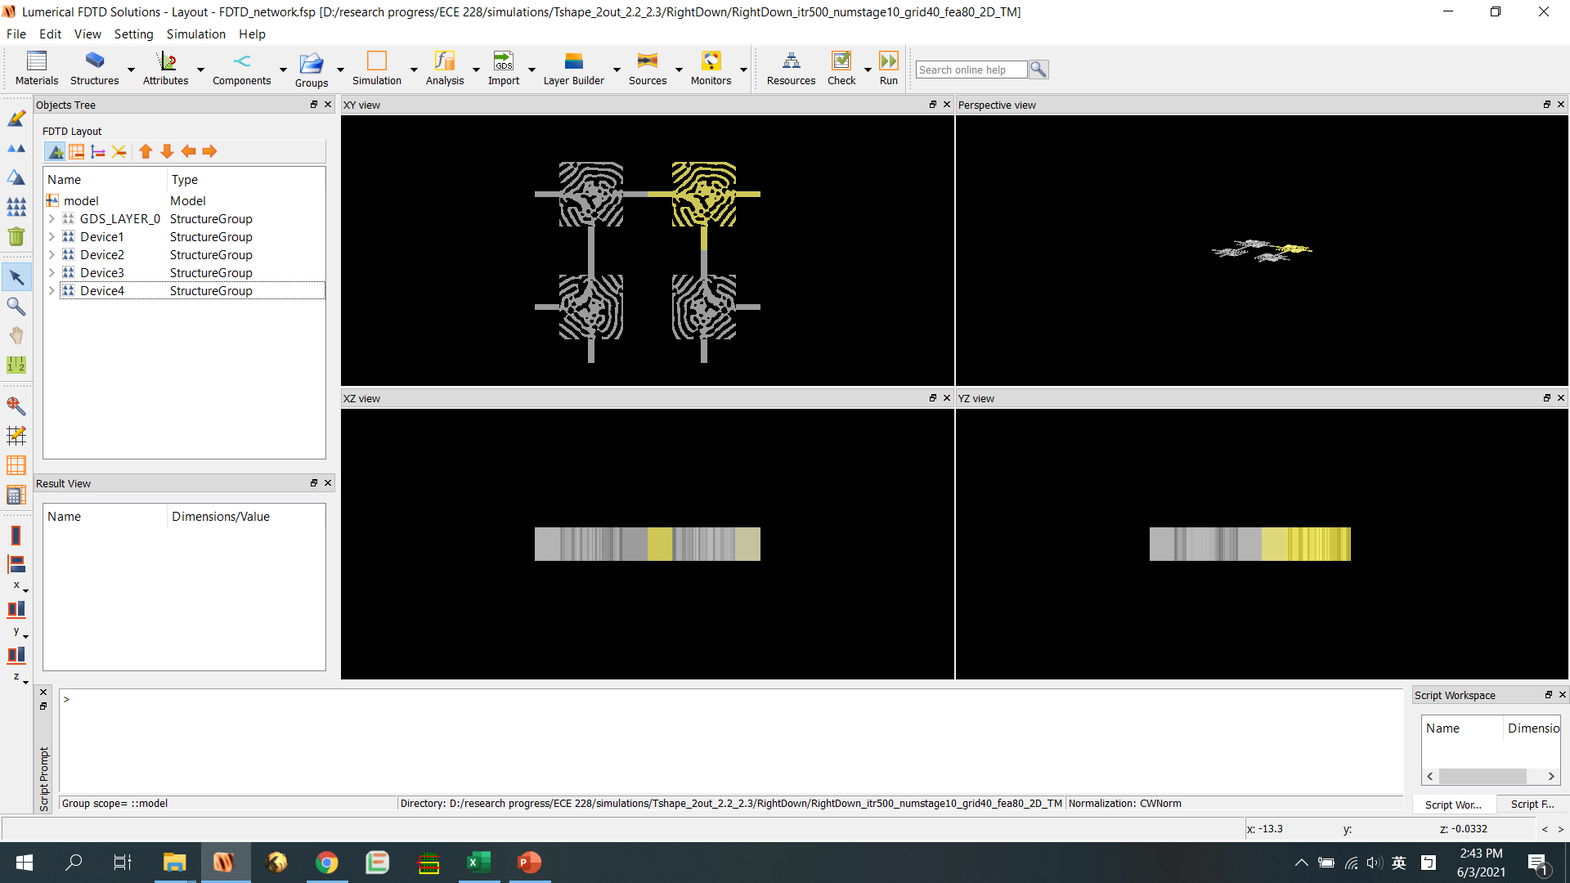

Switch Array Applications
Δn_{Si} = 0
(off-state)
Δn_{Si} = 0.1
(on-state)
Compact on-chip light routing!

Slide 16
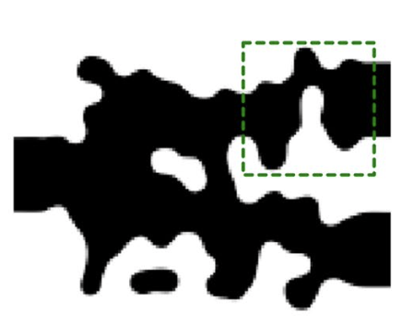
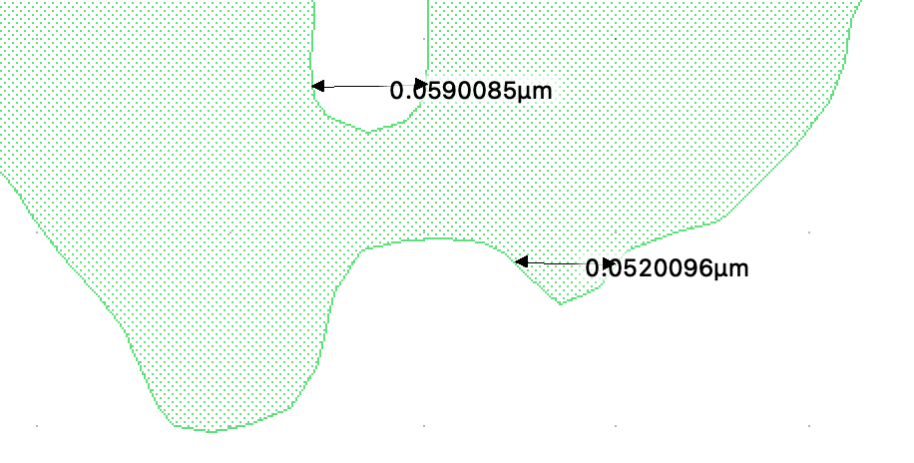
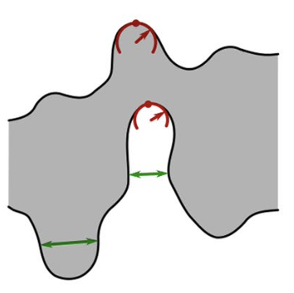
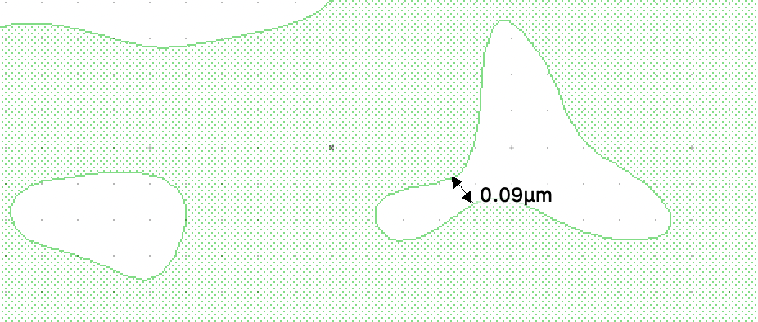
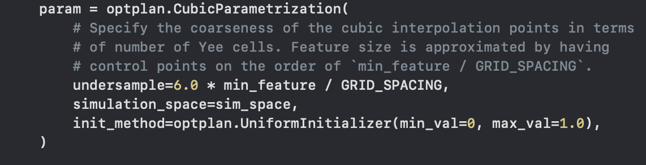
Fabricable Design
The parameter of undersample = 1.0
Example of a discrete device structure
Feature sizes in the green line
The parameter of undersample
We set 80nm minimum feature size and 40nm grid spacing as default
The parameter of undersample = 5.0

Slide 17
References
[1] A. Y. Piggott et al., “Inverse design and demonstration of a compact and broadband on-chip wavelength demultiplexer,” Nature Photon., vol. 9, pp. 374–377, May 2015.
[2] D. A. B. Miller, “Optical interconnects to electronic chips,” Appl. Opt., vol. 49, pp. F59–F70, Jul. 2010.
[3] J. Wang, J. Zhou, L. Zhu and Q. Zhang, “Frequency- and Time-Domain Modeling and Characterization of PN Phase Shifters in All-Silicon Carrier-Depletion Modulators,” J. Light. Technol., vol. 38, no. 16, pp. 4462-4469, Aug. 2020.
[4] M. Jacques, A. Samani, E. El-Fiky, D. Patel, Z. Xing, and D. V. Plant, “Optimization of thermo-optic phase-shifter design and mitigation of thermal crosstalk on the SOI platform,” Opt. Express, vol. 27, pp. 10456-10471, Apr. 2019.
[5] M. J.R. Heck, “Highly integrated optical phased arrays: photonic integrated circuits for optical beam shaping and beam steering,” Nanophotonics, vol. 6, pp. 93-107, Jun. 2016.
[6] V. S.-Y. Lin et al., “A porous silicon-based optical interferometric biosensor,” Science, vol. 278, pp. 840–843, Oct. 1997.
[7] L. Xu et al., “Broadband 1310/1550 nm wavelength demultiplexer based on a multimode interference coupler with tapered internal photonic crystal for the silicon-on-insulator platform,” Opt. Lett., vol. 44, pp. 1770-1773, Mar. 2019.
[8] L. Su et al., “Nanophotonic inverse design with SPINS: Software architecture and practical considerations,” Appl. Phys. Rev., vol. 7, pp. 011407, Mar. 2020.

Slide 18
Thanks for your attention!

